Slide 1
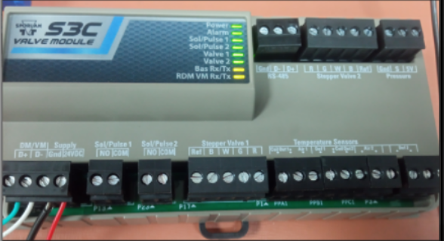
Division: Sporlan
S3C Valve Module Firmware Porting
Scope
The scope of the project was to port the existing Valve Module (VM) code to Geehy microcontroller from ST microcontroller.
Due to product supply issues with ST microcontroller part, porting to Geehy is started.
Verify functional tests on new Valve Module (VM) using the Geehy microcontroller.
Challenges
Single hex file support for both ST and Geehy microcontrollers.
Identifying microcontroller vendor to run right library during run time.
Environment
Eclipse IDE
32-bit ARM Cortex Microcontroller
J-Link Debugger
Modbus RTU
Modbus Poll application
Benefits and Improvements
Solution
S3C Valve module product continuity without any hardware changes in PCB with new Geehy microcontroller.
Single hex file for S3C value module which runs on both ST and GEEHY microcontrollers.

